Slide 1
S.Reethika
Final Project
3/21/2024 Annual Review

Slide 2
PROJECT TITLE
Hand Gesture Recognition using CNN
3/21/2024 Annual Review

Slide 3


AGENDA
PROBLEM STATEMENT
PROJECT OVERVIEW
END USERS OF PROJECT
SOLUTION AND ITS VALUE PROPOSITION
UNIQUE SOLUTION
MODELLING
RESULT
3/21/2024 Annual Review

Slide 4

PROBLEM STATEMENT
Develop a Convolutional Neural Network (CNN) model for recognizing hand gestures in images.
The goal is to accurately classify different hand gestures such as thumbs up, peace sign, fist, etc., from input images.
The model should be able to generalize well on a variety of hand gestures and achieve high accuracy in classification.
Hand gesture recognition using CNN involves training a deep learning model to classify images of hand gestures into different categories
3/21/2024 Annual Review

Slide 5

PROJECT OVERVIEW
The objective of this project is to develop a robust Convolutional Neural Network (CNN) model for recognizing and classifying hand gestures in images.
The model will be trained on a dataset of hand gesture images and will be capable of accurately identifying various gestures such as thumbs up, peace sign, fist, etc.
Key components of the project will include data collection of hand gesture samples, preprocessing techniques to enhance the quality of input data, designing and training neural network models for gesture recognition, and integrating the system for real-time interaction.
The project will focus on optimizing the neural network architecture to achieve fast and accurate gesture recognition while ensuring a user-friendly and responsive interface.
3/21/2024 Annual Review

Slide 6

WHO ARE THE END USERS?
Accessibility Advocates: Individuals with disabilities who could benefit from gesture recognition systems as an alternative input method for interacting with devices.
Virtual Reality (VR) and Augmented Reality (AR) Users: People using VR/AR applications who can benefit from intuitive gesture-based interactions within virtual environments.
Education Sector: Educators and students interested in exploring new ways of interacting with educational technology through gestures and movements.
Healthcare Professionals: Medical practitioners exploring innovative ways to interact with medical equipment or patient data through gesture controls.
General Consumers: Everyday users seeking more intuitive and hands-free ways to interact with their devices, such as smartphones, smart home devices, or computers.
3/21/2024 Annual Review

Slide 7

YOUR SOLUTION AND ITS VALUE PROPOSITION
Solution: The system will involve collecting a diverse dataset of hand gestures, preprocessing the data to enhance its quality, designing and training neural network models for gesture recognition, and integrating the system for seamless interaction with devices or applications
Value Proposition:
1)Enhanced User Experience: The gesture recognition system offers a more natural and intuitive way for users to interact with devices, enhancing user experience and engagement.
2)Hands-Free Control: Users can control devices or applications without the need for physical input devices, providing a convenient and hands-free interaction method.
3)Improved Accessibility: The system can benefit individuals with disabilities by offering an alternative input method for interacting with technology
3/21/2024 Annual Review

Slide 8

THE WOW IN YOUR SOLUTION
In addition to the core gesture recognition system, a unique aspect of this project could involve the implementation of transfer learning techniques.
By leveraging pre-trained neural network models for general hand and body pose recognition, the system can adapt and fine-tune these models to recognize specific hand gestures with greater efficiency and accuracy.
This approach not only reduces the need for extensive data collection and training from scratch but also enables the system to learn and recognize new gestures more rapidly.
Additionally, the transfer learning approach can enhance the system's performance in scenarios with limited computational resources, making it suitable for a wider range of devices and applications.

Slide 9
MODELLING
Hand Gesture Recognition using Convolutional Neural Networks with TensorFlow and Visualization using Matplotlib
Developing a Hand Gesture Recognition CNN involves gathering a diverse dataset of hand gestures, preprocessing it for training, designing a CNN architecture with TensorFlow, and training it on the dataset.
Visualization using Matplotlib helps analyze training metrics. The model's accuracy is evaluated, and adjustments are made accordingly.
Real-time inference capabilities are implemented for practical use. Optimization techniques ensure efficient deployment on various platforms.
Teams cam add wireframes
3/21/2024 Annual Review

Slide 10
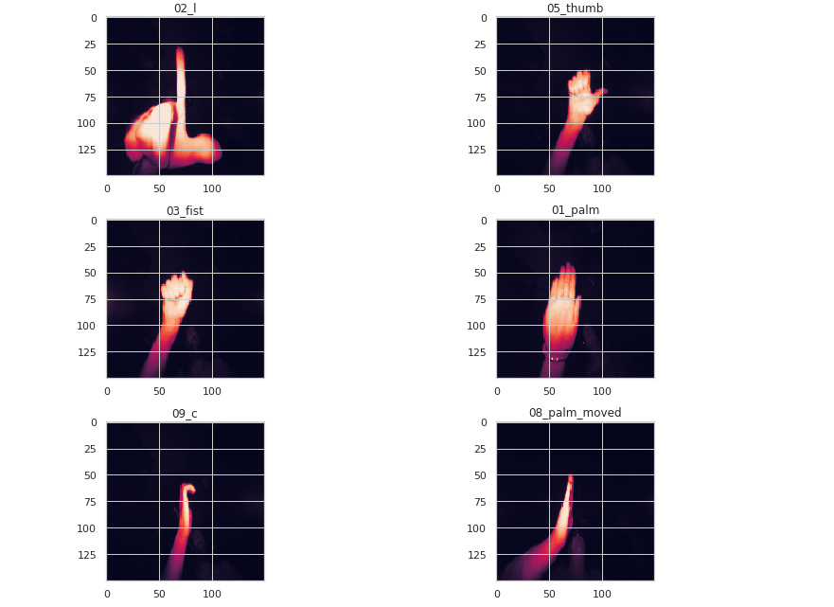
RESULTS
Demo Link
3/21/2024 Annual Review

